Slide 1
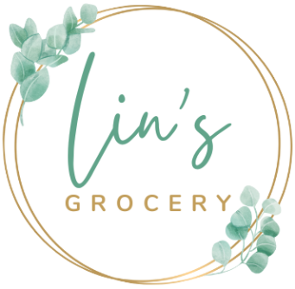
Lin’s Grocery
A Full Stack Project
by
Yotam Lin

Slide 2
Technologies:
JavaScript/HTML/CSS
ReactJS, Redux Toolkit, etc…
ASP .NET / C#
MS SQL Server
A lot of features…

Slide 3
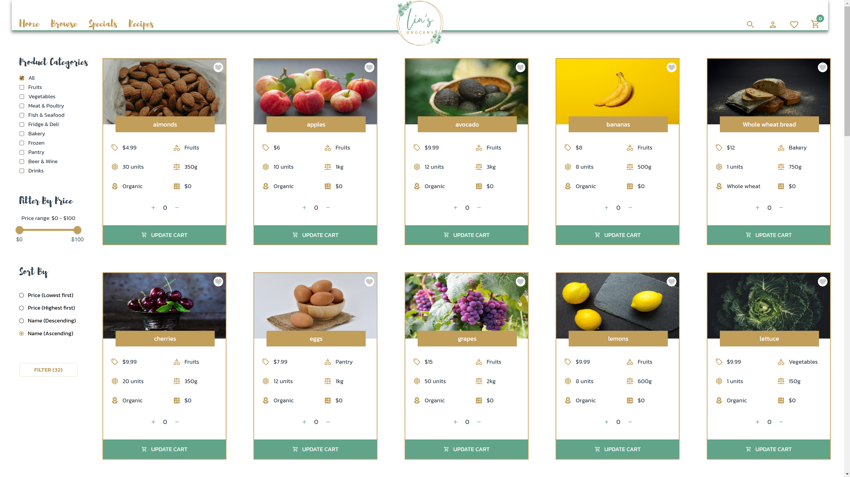
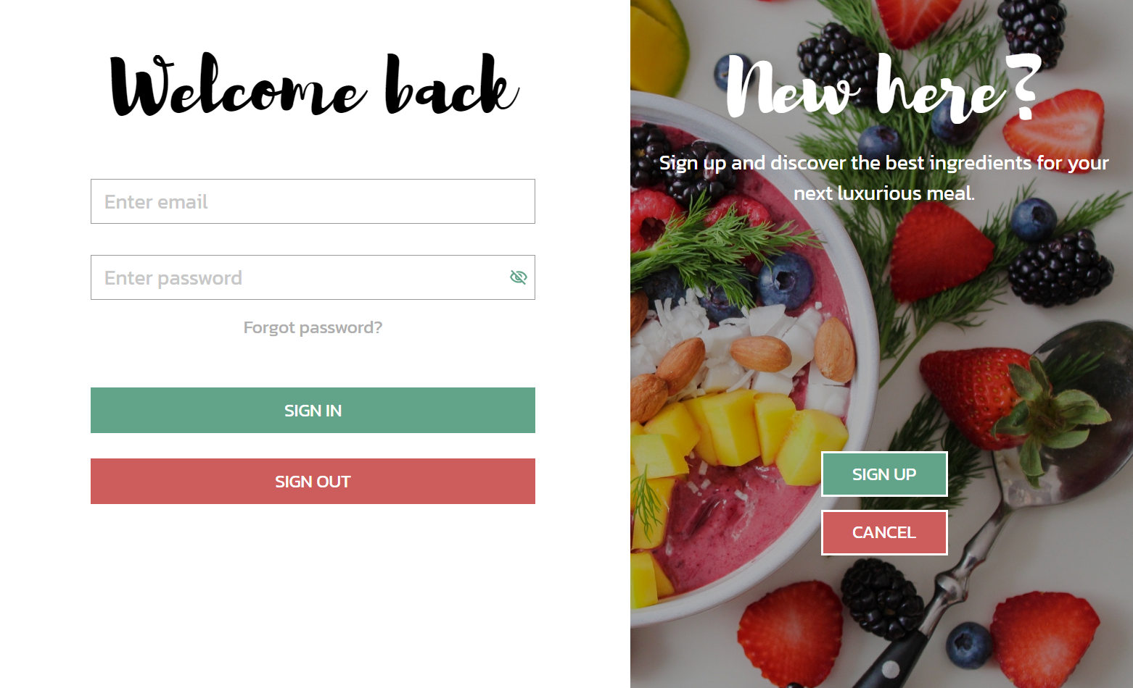
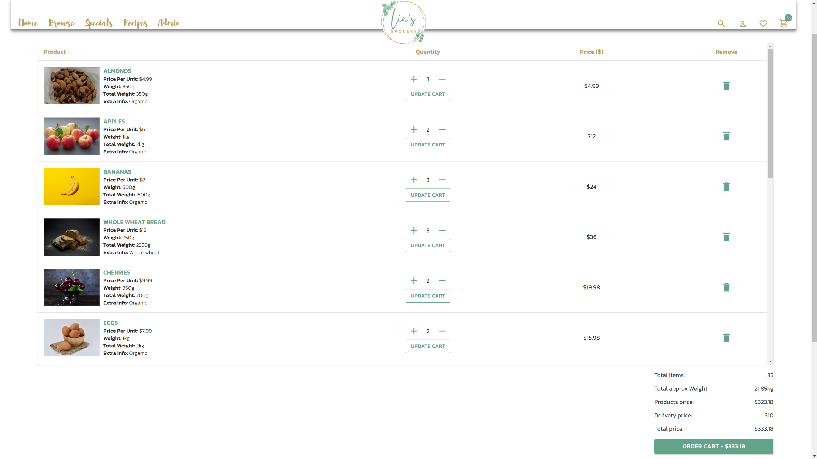
The Website:
A Grocery Store (E-Commerce)
Browse products
Register & Login/Logout
Add items to your shopping cart

Slide 4

Enjoy

